Slide 1
Capstone Engagement
Assessment, Analysis, and Hardening of a Vulnerable System
Christopher DeArmond

Slide 2
Table of Contents
This document contains the following sections:
01
Network Topology
02
Red Team: Security Assessment
03
Blue Team: Log Analysis and Attack Characterization
Hardening: Proposed Alarms and Mitigation Strategies
04

Slide 3
Network Topology
‹#›

Slide 4
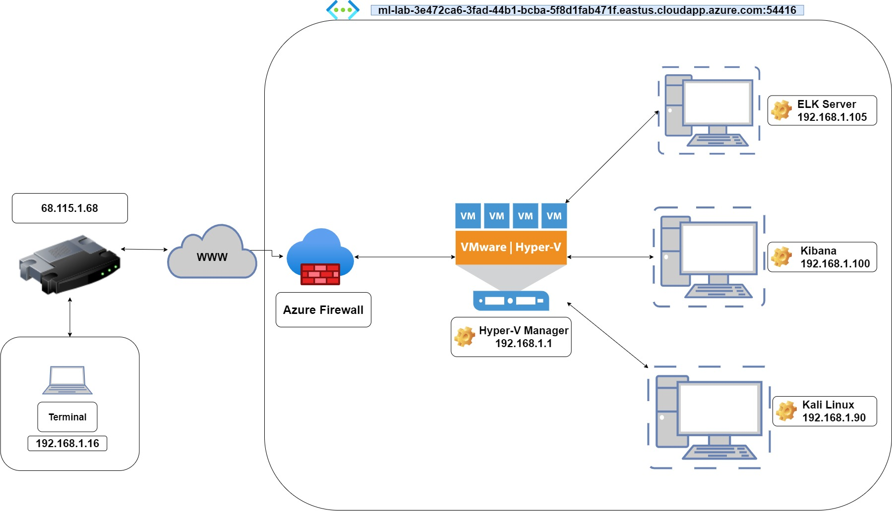
Network Topology
Network
Address Range: 192.168.1.0/24
Netmask: 255.255.255.0
Gateway: 10.0.0.1
Machines
IPv4: 192.168.1.1
OS: Windows 10
Hostname: ML-REFVM-684427
IPv4: 192.168.1.105
OS: Linux
Hostname: Capstone
IPv4: 192.168.1.100
OS: Linux
Hostname: ELK
IPv4: 192.168.1.90
OS: Kali Linux
Hostname: Kali

Slide 5

Red Team
Security Assessment
‹#›

Slide 6
Recon: Describing the Target
Nmap identified the following hosts on the network:
Hostname | IP Address | Role on Network
ML-RefVm-684427 | 192.168.1.1 | NAT Switch
Elk Server | 192.168.1.100 | Log Manager and Visualization
Capstone | 192.168.1.105 | Web Server and Final Target
Kali Linux | 192.168.1.90 | Red Team Platform

Slide 7
Vulnerability Assessment
The assessment uncovered the following critical vulnerabilities in the target:
Vulnerability | Description | Impact
Apache 2.4.29 Directory Listing Enabled | A simple enumeration scan reveals the entire file structure of the site with indexed files. | Quickly map points of interest and shows what files are available to be investigated
WebDav Vulnerability | WebDav is essentially an FTP service. | WebDav can allow an actor with stolen credentials to upload and download resources directly.
Unsanitized txt file hosted on-site | Ashton.txt specifically refers to a hidden directory on the site. | Knowing that the hidden directory exists the attacker can put all of their energy into one target.
No password lockout policy | There is no lockout if an incorrect password is entered after a set amount of attempts. | Using Hydra against the secret folder revealed the users password.

Slide 8
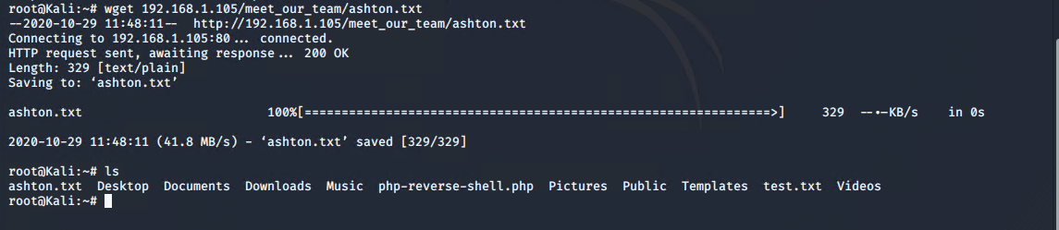
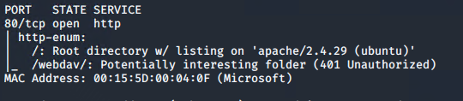
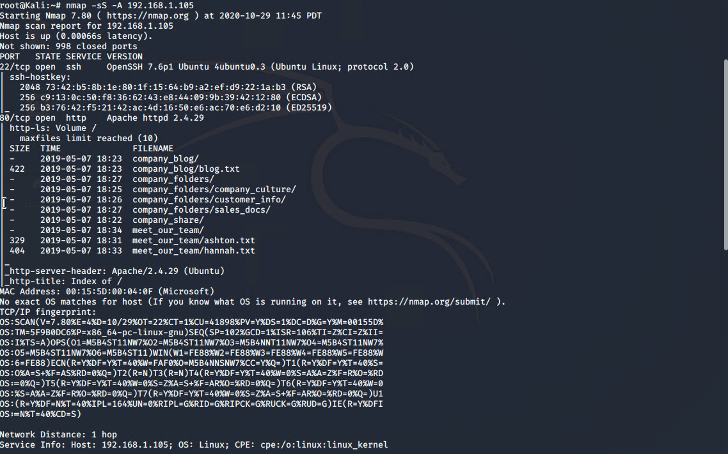
Exploitation: Apache Directory Listing
01
02
03
Tools & Processes
Using nmap with flags such as the -sS -O and -A I found a wealth of information and targets. Together with ‘nmap -v --script /root/hacking/http-enum.nse 192.168.1.105’ revealed the webdav application.
Achievements
I was able to locate the .txt file for ashton revealing the secret folder.
[INSERT: screenshot or command output illustrating the exploit.]

Slide 9
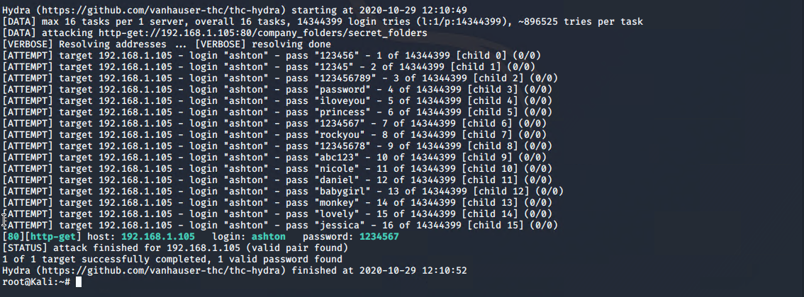
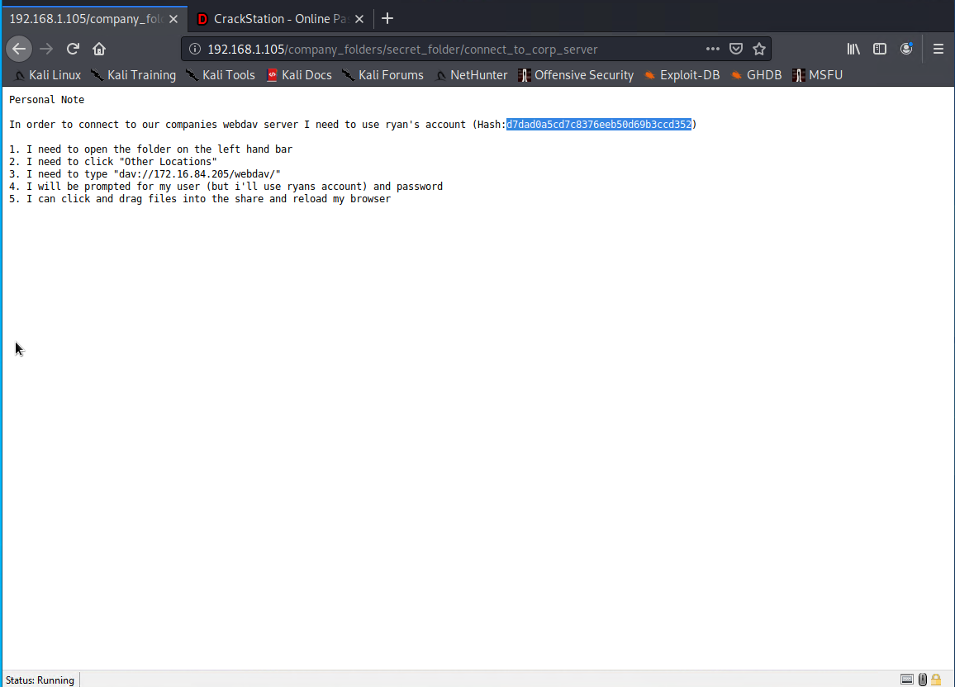
Exploitation: No Password Lockout Policy
01
02
03
Tools & Processes
Knowing that the secret directory existed and knowing that Ashton was the page admin I used Hydra to attempt to bruteforce the password.
Achievements
Hydra was able to crack the password and I gained access to the secret Directory. Once in I found a .txt Document detailing how to access the Webdav server. The user name of Ryan and a hashed copy of his password were also in the file.

Slide 10
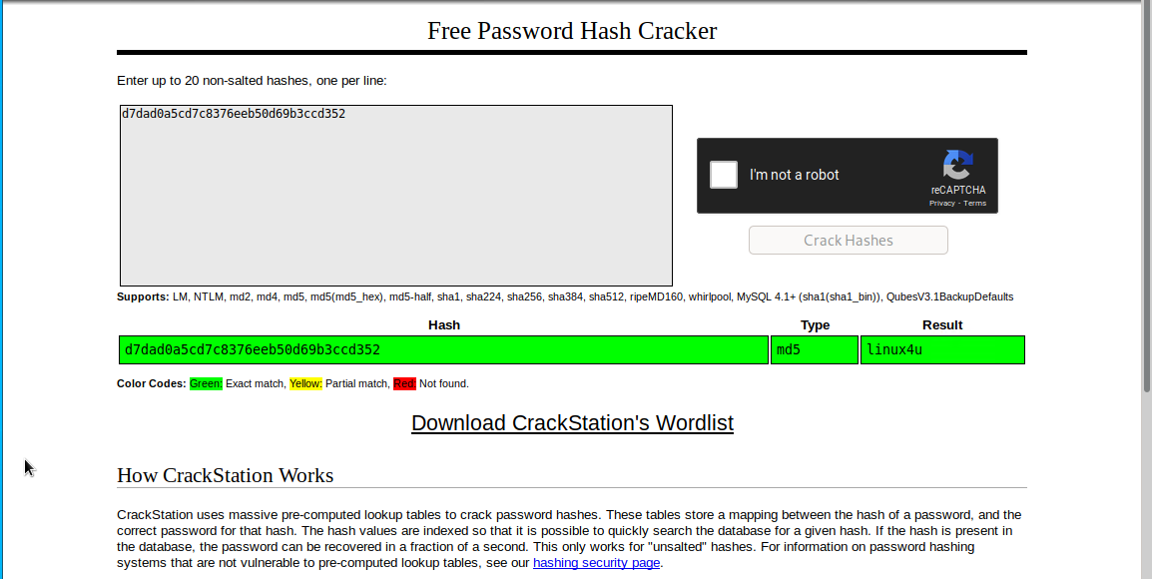
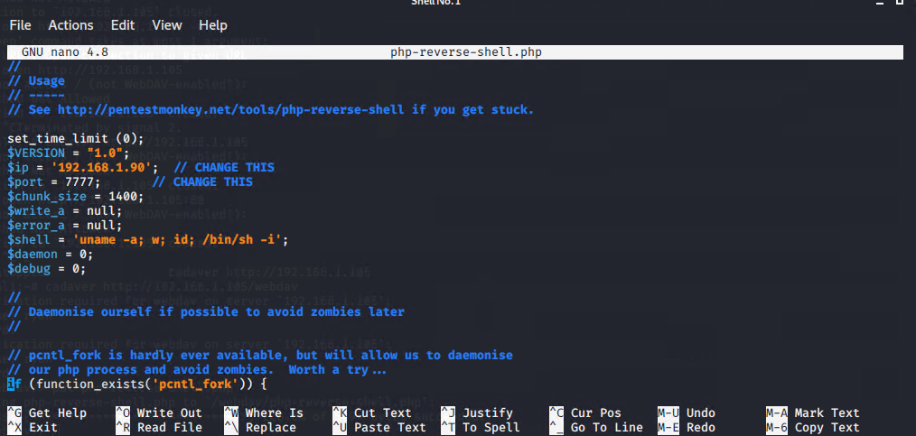
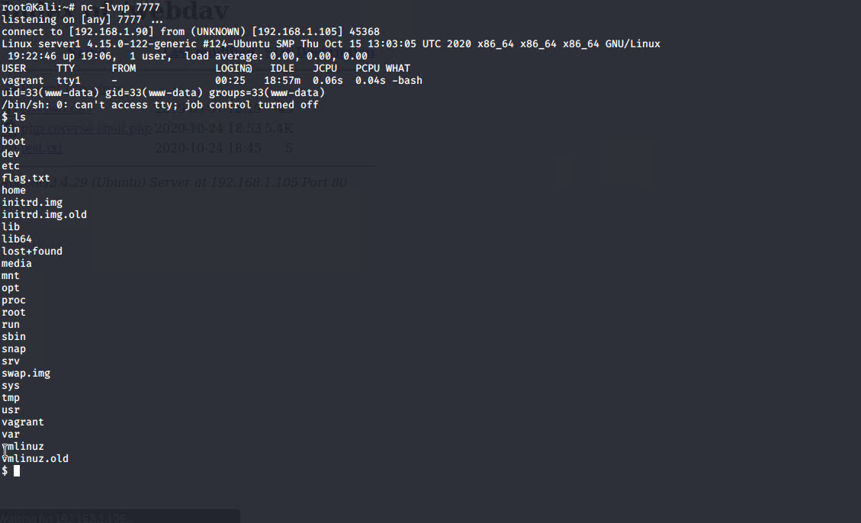
Exploitation: WebDav File Sharing
01
02
03
Tools & Processes
After obtaining Ryans hashed Password I used crackedstation.com and was able to obtain the plain text password. Using this I used Cadaver to connect to the Webdav server and was able to upload a reverse shell.
Achievements
I was able to generate a reverse shell with full access to the Webdav contents.

Slide 11

Blue Team
Log Analysis and Attack Characterization
‹#›

Slide 12

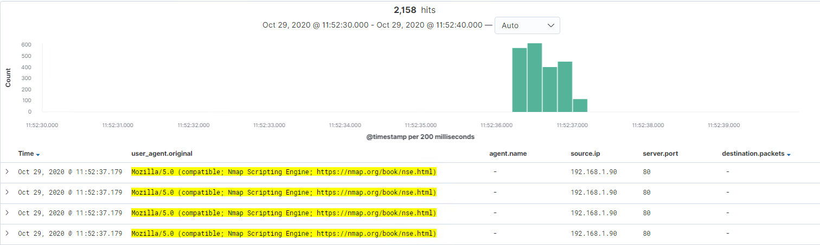
Analysis: Identifying the Port Scan
Answer the following questions in bullet points under the screenshot if space allows. Otherwise, add the answers to speaker notes.
What time did the port scan occur?
How many packets were sent, and from which IP?
What indicates that this was a port scan?
[Insert Here]
Include a screenshot of Kibana logs depicting the port scan.
Notes:
The Port Scan occured between 11:52:30 and 11:52:40 on October 29th. The scan shows the Nmap scripting engine, a known port mapper. A total of 2,158 packets were sent from 192.168.1.90

Slide 13
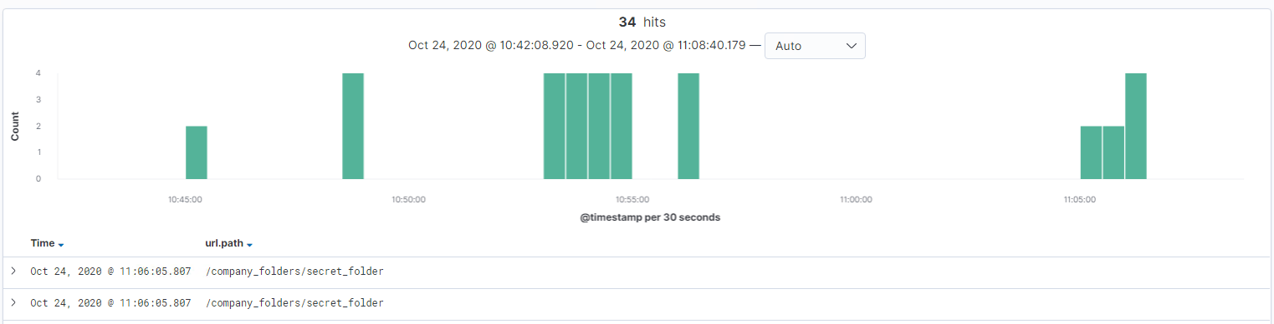
Analysis: Finding the Request for the Hidden Directory
Answer the following questions in bullet points under the screenshot if space allows. Otherwise, add the answers to speaker notes.
What time did the request occur? How many requests were made?
Which files were requested? What did they contain?
Notes:
The request occured between approximately 10:45 am and 11:10 am. The original requests appear to be the brute force attack and the proceeding requests was able to access the instructions to connect to the Corporate Server.

Slide 14
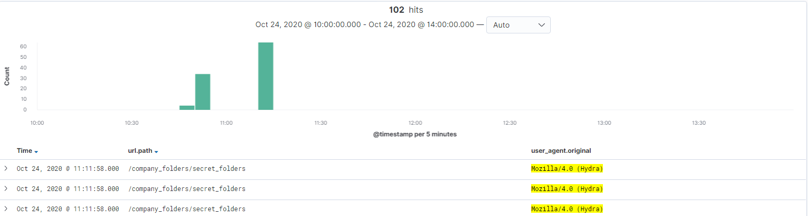
Analysis: Uncovering the Brute Force Attack
Answer the following questions in bullet points under the screenshot if space allows. Otherwise, add the answers to speaker notes.
How many requests were made in the attack?
How many requests had been made before the attacker discovered the password?
Notes:
There were a total of 102 attacks using the password brute forcer agent Hydra, before the attacker was able to gain access to the directory.

Slide 15
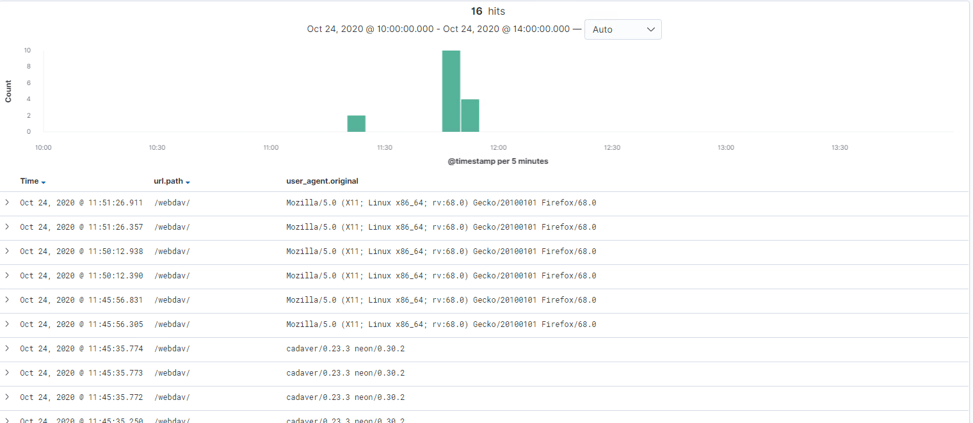
Analysis: Finding the WebDAV Connection
Answer the following questions in bullet points under the screenshot if space allows. Otherwise, add the answers to speaker notes.
How many requests were made to this directory?
Which files were requested?
[Insert Here]
Add a screenshot of Kibana logs depicting the WebDAV connection.
Notes:
Here we can see that Webdav was accessed a total of 16 times. These included the original access with the compromised credentials, the uploading of the php reverse shell payload and the extraction of the flag.txt file.

Slide 16
Blue Team
Proposed Alarms and Mitigation Strategies
‹#›

Slide 17
Mitigation: Blocking the Port Scan
What kind of alarm can be set to detect future port scans?
A port ping and syn alarm can be set when the requests exceed more than 3 per second across multiple ports from the same originating IP.
What configurations can be set on the host to mitigate port scans?
1. Drop incoming Ping request Packets.
2. Implement a CMS Manager to deny ping sweeps and port scans.

Slide 18
Mitigation: Finding the Request for the Hidden Directory
What kind of alarm can be set to detect future unauthorized access?
Alert SOC whenever an unknown IP attempts to access the directory.
What configuration can be set on the host to block unwanted access?
Whitelist authorized internal IP’s and explicitly deny all others.
Set-up two-factor authentication
Scrub all public facing documents for any mention of secret directories or proprietary company information.

Slide 19
Mitigation: Preventing Brute Force Attacks
What kind of alarm can be set to detect future brute force attacks?
Alert SOC when the number of failed logins exceeds 3, also alert SOC if the time between attempts is less than 5 seconds.
What configuration can be set on the host to block brute force attacks?
Enable user agent blocking from known Hydra sources.
Enable account lockout after 5 failed login attempts.
Enable account login delay timer between failed attempts.

Slide 20
Mitigation: Detecting the WebDAV Connection
What kind of alarm can be set to detect future access to this directory?
Alert SOC when an IP outside of the Whitelist is attempting to access the WebDav Service.
Alert the SOC of any file upload(s) originating from outside the Corporate Network.
What configuration can be set on the host to control access?
Enable Two-factor Authentication
Deny access by IP’s outside of the network.

Slide 21
Mitigation: Identifying Reverse Shell Uploads
What kind of alarm can be set to detect future file uploads?
Alert SOC if any attempt is made to upload files from outside the Corporate Network.
What configuration can be set on the host to block file uploads?
Deny uploading of .php files.
Deny uploads from IP’s outside the Corporate Network.
Christopher DeArmond

